Slide 1
AI-Powered Collections Strategy
Leveraging Agentic AI for Scalable, Fair, and Effective Debt Management at Geldium

Slide 2
How the System Works
1. Workflow Outline:
Inputs → Analysis → Risk Scoring → Action Triggers → Learning Loop
Notes:
Prompts to try:
Generate a simple outline for an AI collections system workflow, including inputs, decision logic, action triggers, and learning loop.
List 3–5 key customer attributes that would be most predictive for collections decision-making, and explain why each one matters.
Suggest examples of business rules and AI-driven actions the system could use at different risk levels (e.g., low, medium, high risk).
Create a rough sketch or step-by-step description of how customer data flows through the system from intake to action.

Slide 3
How the System Works
Data Intake
Pull in customer data (financial history, behavior, credit profile, payment trends)
Feature Engineering
Calculate engineered variables (e.g., missed payments trend, risk score)
Risk Classification
Apply trained AI model (Random Forest) to predict delinquency probability
Risk Tier Assignment
Customers are segmented into Low, Medium, or High Risk
Action Trigger
Based on risk level, tailored collection strategies are deployed
Learning Loop
System captures outcome of each action (e.g., repayment, default)
Retrains model periodically for improved accuracy and fairness
Notes:
Prompts to try:
Generate a simple outline for an AI collections system workflow, including inputs, decision logic, action triggers, and learning loop.
List 3–5 key customer attributes that would be most predictive for collections decision-making, and explain why each one matters.
Suggest examples of business rules and AI-driven actions the system could use at different risk levels (e.g., low, medium, high risk).
Create a rough sketch or step-by-step description of how customer data flows through the system from intake to action.

Slide 4
How the System Works
Key Predictive Customer Attributes:
Attribute | Why It Matters
Missed_Payments | Complex non-linear behavior; strong delinquency signal
Employment_Status | 'Unemployed' = higher risk
Credit_Card_Type | 'Business' card = highest delinquency
Debt_to_Income_Ratio | Indicates credit stress
Credit_Utilization | Weakly correlated, but meaningful
Credit_Score, Income, Loan_Balance, Location, Account_Tenure | All contribute to financial profile
Month_1 to Month_6 | Used to engineer temporal risk features
Notes:
Prompts to try:
Generate a simple outline for an AI collections system workflow, including inputs, decision logic, action triggers, and learning loop.
List 3–5 key customer attributes that would be most predictive for collections decision-making, and explain why each one matters.
Suggest examples of business rules and AI-driven actions the system could use at different risk levels (e.g., low, medium, high risk).
Create a rough sketch or step-by-step description of how customer data flows through the system from intake to action.

Slide 5
How the System Works
Decision Logic & AI-Driven Actions by Risk Tier:
Risk Level | Business Rule | AI Action
Low Risk | No missed payments, low utilization | Send friendly reminders via email/SMS
Medium Risk | Some late payments, rising credit usage | Personalized payment plan suggestions; in-app nudges
High Risk | Missed payments + unemployment or high debt | Human agent contact + AI-prioritized escalation workflow
Notes:
Prompts to try:
Generate a simple outline for an AI collections system workflow, including inputs, decision logic, action triggers, and learning loop.
List 3–5 key customer attributes that would be most predictive for collections decision-making, and explain why each one matters.
Suggest examples of business rules and AI-driven actions the system could use at different risk levels (e.g., low, medium, high risk).
Create a rough sketch or step-by-step description of how customer data flows through the system from intake to action.

Slide 6
How the System Works
Data Flow – Step-by-Step (Customer Journey):
Customer Data Intake
Real-time or batch feed from CRM/core system
Model Scoring
AI model evaluates risk of delinquency
Risk Segmentation
Customer is classified into a risk category
Action Assignment
Business logic + AI determine best-fit intervention
Action Execution
Automated message sent or case assigned to collections team
Outcome Monitoring
Payment status tracked
Feedback Loop
Outcome used to retrain model quarterly (active learning)
Notes:
Prompts to try:
Generate a simple outline for an AI collections system workflow, including inputs, decision logic, action triggers, and learning loop.
List 3–5 key customer attributes that would be most predictive for collections decision-making, and explain why each one matters.
Suggest examples of business rules and AI-driven actions the system could use at different risk levels (e.g., low, medium, high risk).
Create a rough sketch or step-by-step description of how customer data flows through the system from intake to action.

Slide 7
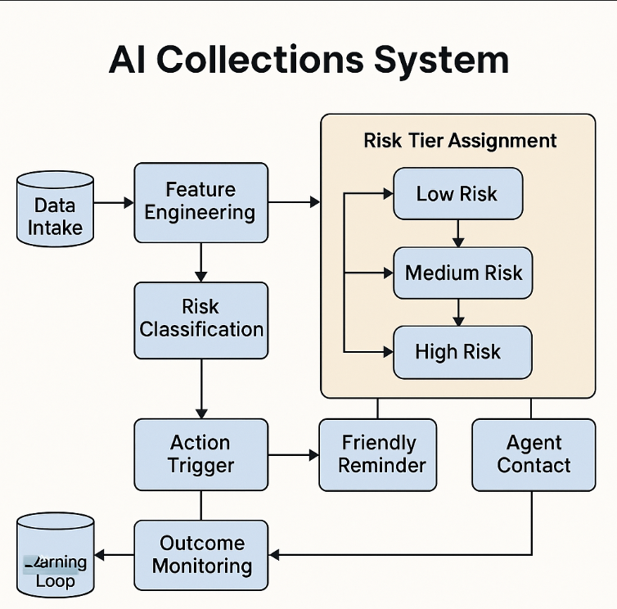
How the System Works
Notes:
Prompts to try:
Generate a simple outline for an AI collections system workflow, including inputs, decision logic, action triggers, and learning loop.
List 3–5 key customer attributes that would be most predictive for collections decision-making, and explain why each one matters.
Suggest examples of business rules and AI-driven actions the system could use at different risk levels (e.g., low, medium, high risk).
Create a rough sketch or step-by-step description of how customer data flows through the system from intake to action.

Slide 8
Role of Agentic AI
Balanced Automation with Human Oversight :
Agentic AI enables the system to operate with a degree of autonomy, especially in routine and scalable actions. However, critical, high-impact decisions (like hardship negotiations) are escalated to humans to ensure empathy, ethical handling, and fairness.
Autonomous vs. Human Oversight – Example Table
Autonomous Actions | Human Oversight Required
Send friendly reminder emails/SMS | Approving/negotiating personalized hardship payment plans
Auto-classify customers by risk tier (Low/Medium/High) | Escalating chronic delinquents to legal/recovery departments
Schedule follow-up reminders | Handling customer disputes or special circumstances
Offer pre-approved standard payment plans | Overriding system decisions in case of error or flagged anomalies
Monitor model performance and retrain periodically | Final review of high-risk segment actions
Notes:
Prompts to try:
Explain how agentic AI could automate financial collections while keeping humans in critical decision points.
List 3–5 examples of collection actions, and classify each as best suited for full automation or requiring human oversight, with a brief reason why.

Slide 9
Role of Agentic AI
How Agentic AI Enables Smart Automation:
Uses historical and real-time data to automate decisions like messaging and timing.
Operates independently in low-impact scenarios (e.g., payment nudges).
Flags edge cases and hands off to humans for sensitive decision-making.
Learns from human corrections to improve future recommendations (active learning).
Notes:
Prompts to try:
Explain how agentic AI could automate financial collections while keeping humans in critical decision points.
List 3–5 examples of collection actions, and classify each as best suited for full automation or requiring human oversight, with a brief reason why.

Slide 10
Role of Agentic AI
Collection Actions & Oversight Classification
Collection Action | Automation Level | Reason
Send email/SMS reminder | ✅ Full Automation | Low risk, scalable
Offer standard 3-month payment extension | ✅ Full Automation | Pre-approved logic, no judgment
Initiate call for financial counseling | 🔍 Human Oversight | Needs empathy and discretion
Approve hardship program based on context | 🔍 Human Oversight | Requires case-by-case evaluation
Trigger legal recovery workflow (chronic risk) | 🔍 Human Oversight | Legal compliance, risk of misjudgment
Notes:
Prompts to try:
Explain how agentic AI could automate financial collections while keeping humans in critical decision points.
List 3–5 examples of collection actions, and classify each as best suited for full automation or requiring human oversight, with a brief reason why.

Slide 11
Role of Agentic AI
This blend of agentic automation + human judgment ensures:
📈 Scalability
🛡 Compliance
❤️ Empathy for vulnerable customers
Notes:
Prompts to try:
Explain how agentic AI could automate financial collections while keeping humans in critical decision points.
List 3–5 examples of collection actions, and classify each as best suited for full automation or requiring human oversight, with a brief reason why.

Slide 12
Responsible AI Guardrails
Responsible AI Practices to Be Built In
📊 Fairness Audits by Customer Group
Regularly evaluate model performance (F1, Recall, Precision) across demographics (e.g., age, location, employment) to detect potential bias.
Apply mitigation techniques (reweighting, threshold adjustment) if disparities exceed 10–15%.
🔍 Explainability & Transparency
Use interpretable models or SHAP values to explain why a customer is classified as high-risk.
Enable agents and customers to understand the reasoning behind decisions (e.g., “high utilization + missed payments”).
Notes:
Prompts to try:
List key fairness, transparency, and compliance practices to build into an AI-powered credit collections system.
Suggest specific ways to monitor and audit the system over time to ensure it stays fair, compliant, and effective.

Slide 13
Responsible AI Guardrails
📜 Regulatory Compliance
Ensure full alignment with:
ECOA (Equal Credit Opportunity Act)
GDPR (General Data Protection Regulation)
Any local data usage and customer rights laws (e.g., India’s DPDP Act).
Avoid using protected or proxy attributes (e.g., gender, race).
👨‍💼 Human Oversight & Escalation Protocols
Keep humans in the loop for hardship programs, high-risk escalations, and customer complaints.
All override decisions and exceptions logged for transparency.
Monitoring & Auditing Recommendations
Monthly dashboard with bias drift monitoring
Quarterly model retraining based on updated collections outcomes
Independent AI audit trail for model decisions and risk scoring
Compliance review meetings with legal and business stakeholders
Notes:
Prompts to try:
List key fairness, transparency, and compliance practices to build into an AI-powered credit collections system.
Suggest specific ways to monitor and audit the system over time to ensure it stays fair, compliant, and effective.

Slide 14
Expected Business Impact
📈 Business KPIs: Measuring AI Effectiveness
Key Performance Indicator (KPI) | Why It Matters
↓ Delinquency Rate | Indicates effectiveness in early intervention
↑ Repayment Rate | Measures successful customer recovery
↓ Collections Cost per Case | Automation reduces manual workload and cost
↑ Model Precision & Recall | Ensures fewer false positives/negatives in risk prediction
Fairness Gap ≤ 10% | Ensures equity across customer groups
Notes:
Prompts to try:
Suggest KPIs for an AI-powered collections strategy that balances business outcomes with customer fairness.
Describe 2–3 ways an AI collections system could improve both operational efficiency and customer experience.

Slide 15
Expected Business Impact
💬 Customer Outcomes: Building Trust and Experience
Outcome | Benefit
Improved Fairness & Transparency | Customers feel decisions are justified and consistent
Proactive Support for At-Risk Customers | Offers help (e.g., payment plans) before problems escalate
Faster, Personalized Communication | Reduces frustration with automated reminders & guidance
Greater Trust in Geldium | Builds long-term customer loyalty through ethical AI use
Notes:
Prompts to try:
Suggest KPIs for an AI-powered collections strategy that balances business outcomes with customer fairness.
Describe 2–3 ways an AI collections system could improve both operational efficiency and customer experience.

Slide 16
Expected Business Impact
🔧 Efficiency + Experience Improvements
Automated Low-Risk Handling
Offloads repetitive tasks like reminders, reducing FTE workload
Tiered Collections Flow
Routes high-risk cases directly to agents; improves response time and outcomes
AI-Personalized Messaging
Tailors tone and offers based on customer profile, improving engagement and repayment likelihood
Notes:
Prompts to try:
Suggest KPIs for an AI-powered collections strategy that balances business outcomes with customer fairness.
Describe 2–3 ways an AI collections system could improve both operational efficiency and customer experience.

Slide 17
Final Recommendation
Deploy pilot AI collections system
Keep humans in loop for critical actions
Track results → scale gradually
Focus: Efficiency, fairness, customer trust

